Slide 1

AUDIO TRACKER
Anjitha A

Slide 2

REQUIREMENTS
Actors: user and admin
Admin -add, edit, delete, view audio details
Each audio will have these information like title, artist, album and category
User – view audio details, search, view average rating, add rating

Slide 3
Use Case
Registration - user/admin
Login – user/admin
Add Audio - admin
Update Audio details - admin
Delete audio - admin
List all audios – user/admin
Search audio - user
View details of audios - user
View average rating of audios - user
Add rating – user
usecase-audio tracker1.pdf and audio tracker-Technical_document1.pdf

Slide 4
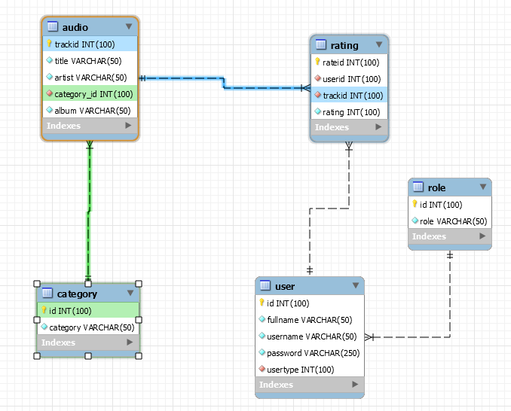
ER Diagram

Slide 5
TASK STATUS
Task Tracker
# | Components | Module / User | Frontend Dev Status |  |  | Backend Dev Status
 |  |  | Coding | Must have items & ReviewComment | Testing | Coding | Must have items & ReviewComment | Testing
1 | Login | Auth / All | Completed | In Progress | In Progress | Completed | completed | Not Started
2 | Registration | Auth / All | completed | In Progress | In Progress | Completed | completed | Not Started
4 | Add-Audio Details | Admin | Completed | In Progress | In Progress | Completed | completed | write on test case, but failed
5 | Update--Audio Details | Admin | completed | In Progress | In Progress | Completed | completed | Not Started
6 | Delete-Audio | Admin | Completed | In Progress | In Progress | Completed | completed | Not Started
7 | Update Master Data(category) | Admin | Not Started | In Progress | In Progress | Inprogress | inprogress | Not Started
8 | List All Audios | All | Completed | In Progress | In Progress | Completed | completed | Not Started
9 | Search- Audios | User | Completed | In Progress | In Progress | Completed | completed | Not Started
10 | View Audio Details | user | completed | In Progress | In Progress | Completed | completed | Not Started
11 | Rate Audios | User | not started | not started | In Progress | Completed | completed | not started
12 | View average rating | User | completed | In Progress | In Progress | Completed | completed | Not Started

Slide 6
Postman collection

Slide 7

THANK YOU..

